Slide 1

Welcome to statics
MET 2124
LEAH GINSBERG, PH.D.

Slide 2

What is statics?
Definition: Study of forces on objects in equilibrium
Notes:
When the bridge was designed in the late 19th century, engineers faced a unique challenge. The bridge needed to allow tall ships to pass along the River Thames while also supporting the immense weight of traffic moving across it. The solution? A bascule (or drawbridge) design, paired with a fixed suspension structure.
The drawbridge sections, or bascules, of Tower Bridge rotate upward using enormous counterweights hidden in the towers. These counterweights reduce the torque required to lift the heavy bascules, a perfect demonstration of moment equilibrium — a core concept in statics. When the bascules are down, the forces acting on the bridge (vehicles, pedestrians, and its own weight) must balance to keep the structure stable. Engineers had to calculate these forces meticulously to ensure that the bridge remains stationary, despite the dynamic loads it endures daily.
Statics teaches us how to analyze these forces and moments, ensuring structures like Tower Bridge remain safe and functional. While the average pedestrian might admire the bridge for its beauty, as engineers, we see a masterpiece of balanced forces and equilibrium.
So, as we embark on this course, keep in mind that the principles you'll learn have built bridges, both literal and metaphorical, throughout history. Who knows? One day, the structure you design might be the next Tower Bridge.

Slide 3
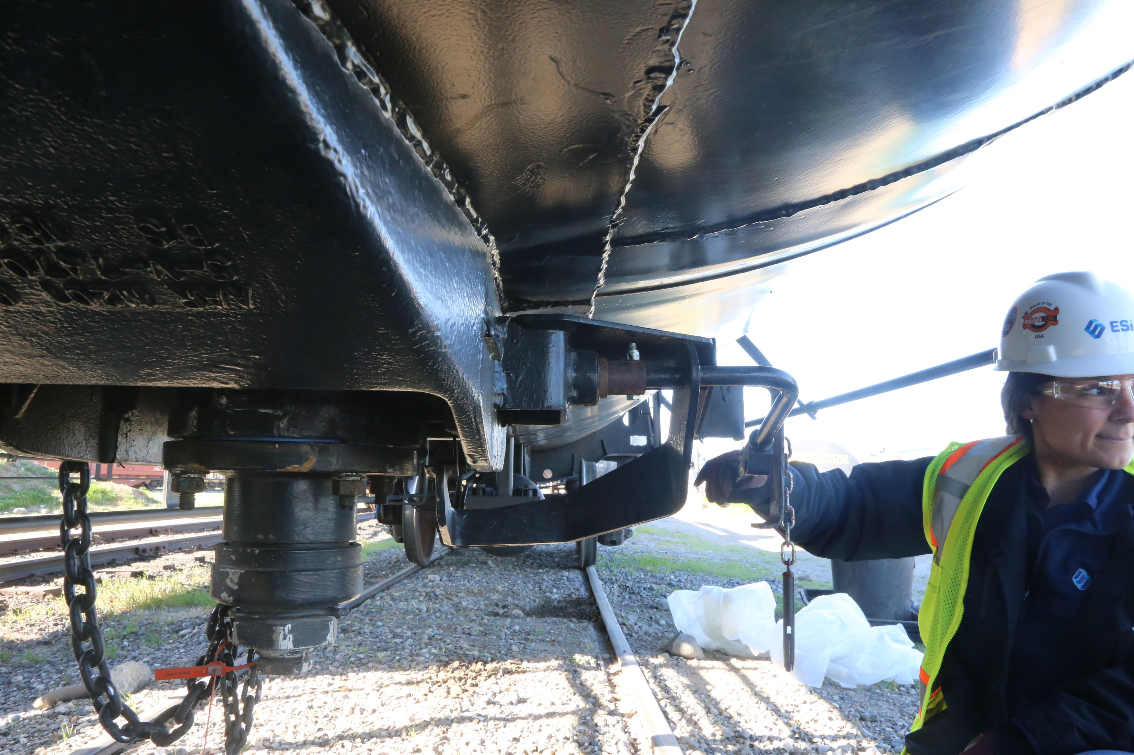

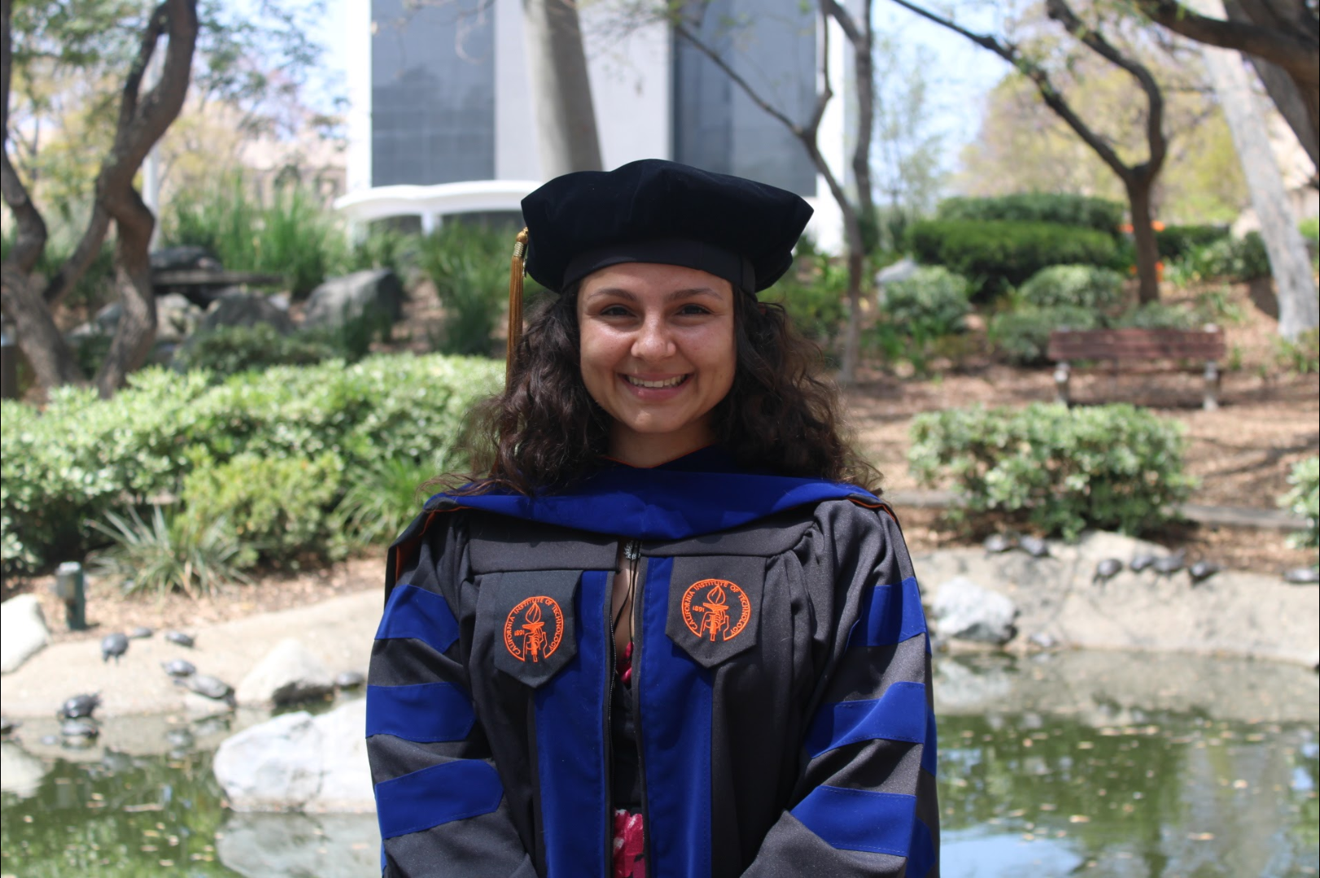
A bit About me - Dr. leah Ginsberg
Notes:
Most importantly, I am here to help you succeed!

Slide 4

Course structure
Most lectures have an associated quiz. The three of these quizzes with the lowest grade will be dropped from your final grade. Make-up quizzes will not be offered.
In-class quizzes will be given throughout the semester and may be announced or unannounced.
I will assign homework problems, but they will NOT be graded.
However, if you participate in the discussion forums by asking/answering questions about the homework, you can get up to two of your lowest in-class quiz grades dropped.
Component | Weight
Lecture Quizzes | 15%
In-Class Quizzes | 10%
Exam #1 | 25%
Exam #2 | 25%
Final Exam | 25%
https://leahmginsberg.com/teaching/2025Spring/MET2124

Slide 5
Unsolicited advice
To get the most out of this class (and other engineering classes), here is my suggestion:
Get enough sleep
Attend lectures – focus on understanding the big picture
If something is not clear, ask! And help your classmates by answering their questions
After each lecture, briefly summarize the notes in your own words
Attend office hours – interact with me and other students
If you get stuck on a problem, ask for help/hints (unless it is an exam problem, and then you are screwed ;-))
My goal is to help you learn and understand the material. Understanding is a creative time- and effort-consuming process. Keep in mind that I am here to help.

